Slide 1
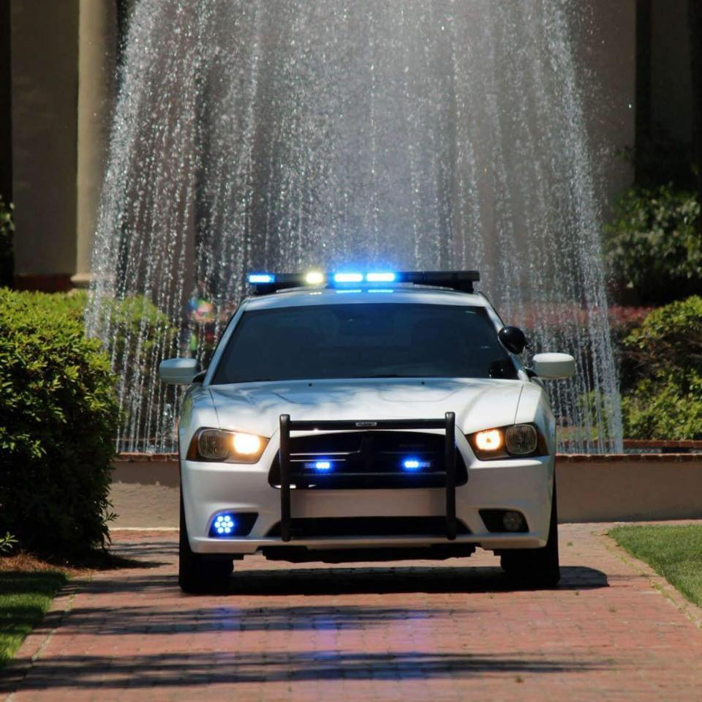
Valdosta State University Police Department
Non-Emergency: (229)333-7816
Emergency: (229)259-5555
www.valdosta.edu/police
Location: Oak Street Parking deck level2

Slide 2
Are VSU PD “real” officers?
* Yes, all officers are certified in accordance with the Georgia Peace Officers Standards and Training Council.
* VSU PD follows Federal, State and Local Laws
* Areas of Operation: Dispatch, Investigations, Patrol, Records
* The Patrol Division is responsible for patrolling the campus and responding to request for service 24 HOURS a day, 365 DAYS YEAR!

Slide 3
Escort Services
* If you are concerned for your safety while going from point A to point B on campus, call the VSU PD and we will walk with you.
* Our service is 24 hours a day seven days a week rain or shine!

Slide 4
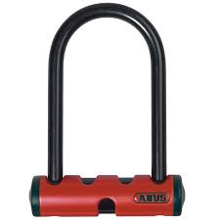
B.A.T (Bicycle Theft Program)
* Bring your bicycle to the VSU PD or we will meet you and fill out the B.A.T. form which will have your bicycle’s information and your contact information.
* A sticker is then given to you to place on your bicycle and after 10:30 pm we stop anyone on campus with that sticker to make sure the bicycle is yours.
* We also keep your bicycle information in our records in case your bicycle is stolen, we will have the information we need for the report.
* Please buy the U-Bolt lock to secure your bicycle on a bike rack.

Slide 5
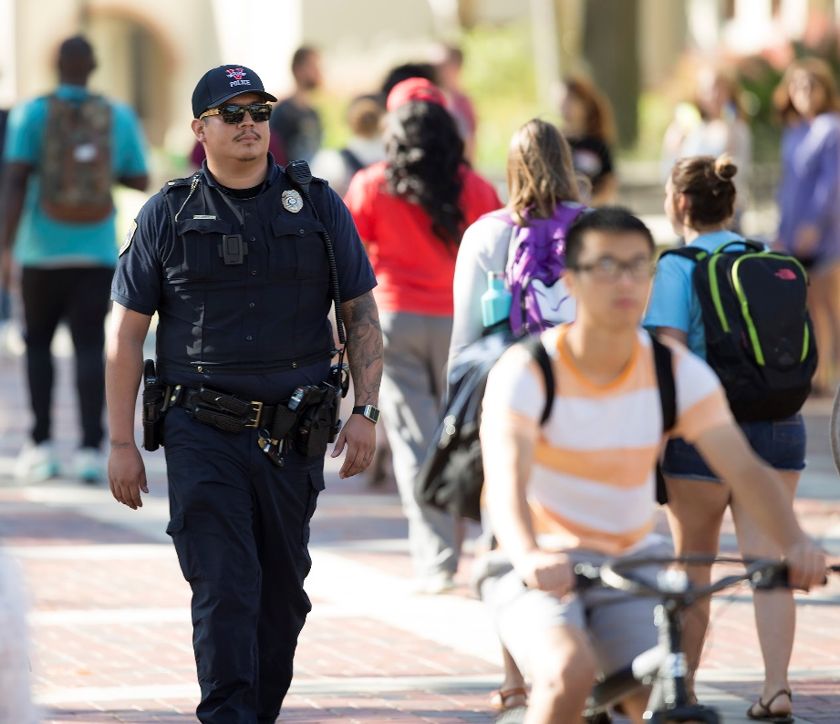
Lost & Found
*If you lose something and you have looked every where for it….Call the vsu pd someone might have turned it in to us.

Slide 6
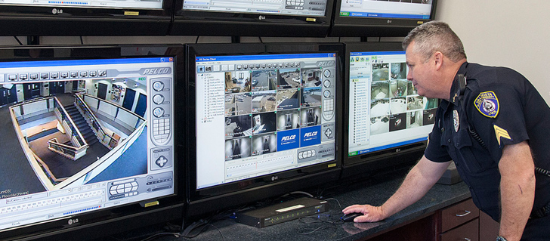
Crime Prevention Tips
*If you leave your dorm room even to use restroom lock your door…..
*When walking around campus pay attention Put your cells phones down and take your ear phones out.
* If your in the library and you leave to get another book or for anything take ALL YOUR PROPERTY with you.
* Lock your bicycle up at all times even if your running inside to turn a paper in.
* Please write down all your serial numbers and IP/Mac address for your valuables.
* At night walk in pairs or groups if possible if not call VSU PD we will walk with you.
* We do have cameras located around campus. If something occurs report it to VSU PD as soon as possible.

Slide 7
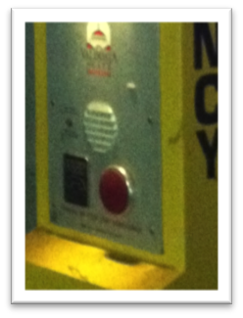
Emergency Phones
* Emergency Phones are located all around campus
* Get familiar with where they are located
* When you press the RED button…..This will allow you to speak with a VSU Dispatcher and a VSU Police Officer will respond IMMEDIATELY.

Slide 8
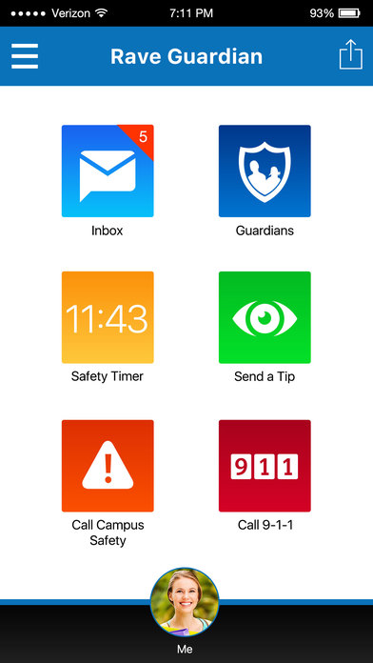
Blazer Guardian App

Slide 9
Furnishing to, purchase of, or possession by persons under 21 years of age of alcoholic beverages;
use of false identification; proper identification;
dispensing, serving, selling, or handling by persons under 21 years of age in the course of employment;
seller's actions upon receiving false identification
First Offense
A fine of up to $300
Sentenced up to six months in jail
Driver’s license suspension for six months
Second or Subsequent Offense
A fine of up to $1,000
Sentenced up to one year in jail
Driver’s license suspension for one year

Slide 10
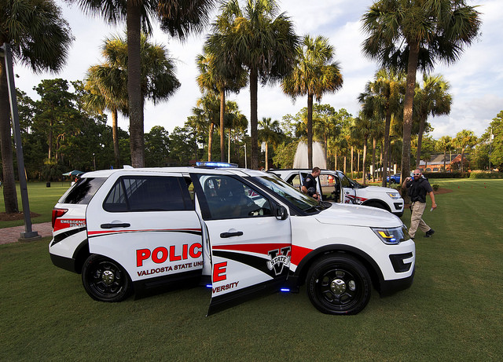
* IF YOU SEE SOMETHING…SAY SOMETHING!!!!*

